Slide 1
Reproducible Clinical Data Analysis with R and RStudio
Session 4
Reproducible Reports

Slide 2
Introduction | 8:30 – 10:00
Getting Data | 10:10 – 11:45
Lunch | 11:45 – 12:30
Exploring Data | 12:30 – 2:30
Reproducible Reports | 2:40 – 4:00

Slide 3
Anatomy of a Reproducible Report
Notes:
Deep dive into a reproducible report

Slide 4
Your Turn #1
Open esr-report.Rmd.

Slide 5
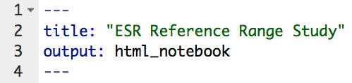
Header
title:
Document title
starts and ends with 3 dashes
output:
must say html_notebook
Notes:
Follow animations

Slide 6

“Copy/Paste” Code
“Write Yourself” Code
Notes:
Realistically when you start writing R Markdown, you’ll often start by copy/pasting some template code and then tweak it until you get what you want.
I believe it’s useful conceptually to distinguish roughly between two types of code I’ll present today--
The first is what I called “Copy/Paste Code” – this is code with commands that might look unfamiliar. For the purpose of this course, don’t worry about how it works in detail but focus on its purpose – in practice, you’ll be able to copy/paste, potentially with very minor modifications. I’ll place that icon with the two pieces of paper next to that kind of code.
Then there’s code where we use the commands we went over for the past two sessions. I call that “Write Yourself” code. This is code that you’ll want to be able to follow along in detail. I’ll place the icon with the hands typing on the keyboard next to that kind of code.

Slide 7
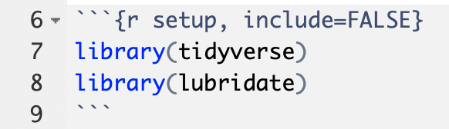
“Setup” Chunk
chunk name (optional)
“chunk option”
don’t show code in rendered document
for dealing with dates
Notes:
All code chunks start with three backticks, and then curly braces that say r right after the opening brace. In this case, there are also two extra items
“setup” this is a label for a this code chunk, completely optional
Include = FALSE. This is a chunk option that tells R what to do with this particular chunk to render it. If you check the back of the R Markdown ref guide, you’ll see that if you set the chunk option include = FALSE R will run the code chunk but not include its code in the final document. The setup chunk is often hidden, well, because it’s ugly.
Again, please run each code chunk as we go. Otherwise you will get errors further down below since the lower down code depends on higher up code. When you run this, it will look like nothing happened, but under the hood R loaded the tidyverse and lubridate packages and their functions are now available for us to use in the code below.

Slide 8
Background and Objectives
Data Acquisition
Data Exploration and Cleaning
Visualization and Modeling
Summary
Notes:
Here’s an overview of the sections of a typical reproducible report. We’ll look through each one in more detail.

Slide 9
Background and Objectives
What is the question to be addressed by the analysis?
How could addressing this question change patient management or further generalizable knowledge? (What’s the point of doing this?)
What are the 1-2 key graphs or statistics that should be generated to begin to address the question?
Notes:
The purpose of the Background and Objectives section is to make sure to give enough background to yourself and others to understand the rationale behind the analysis you’re undertaking.
So they questions you’ll want to address here are: …

Slide 10
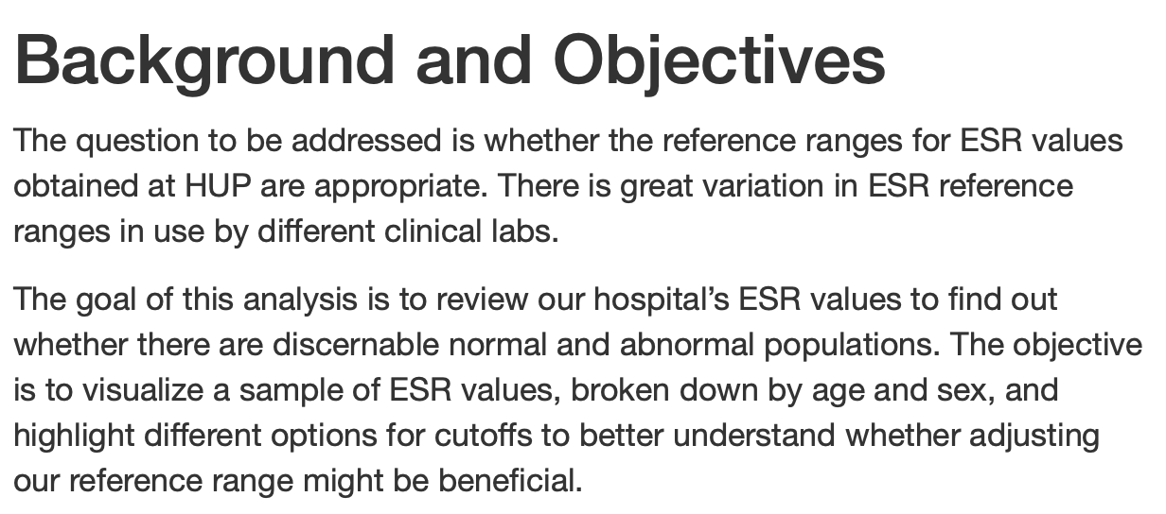

Slide 11
Background and Objectives
Data Acquisition
Data Exploration and Cleaning
Visualization and Modeling
Summary

Slide 12
Data Acquisition
Narrative
General properties of the data set
“Code book”
Databases
Database server address
Database table name
Files
Origin, with references
File name and format
Code
Database sources
Connection and query
Don’t hard-code login credentials!
Disconnect
Data file sources
Data import
Isolation of data of interest

Slide 13
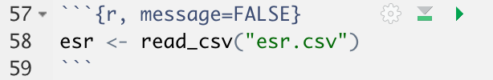
don’t print any messages
run current code chunk
run all code chunks above the current one
(great for fixing things)

Slide 14
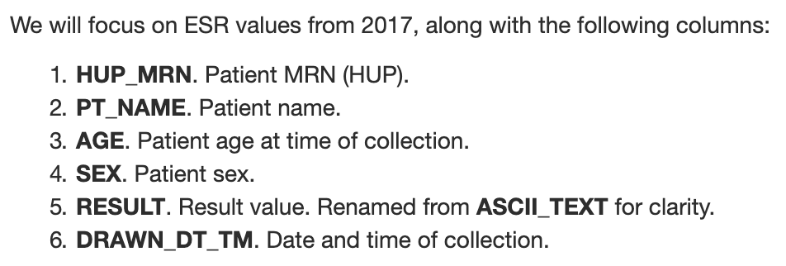
Code Book
Notes:
Remove from printed slides

Slide 15
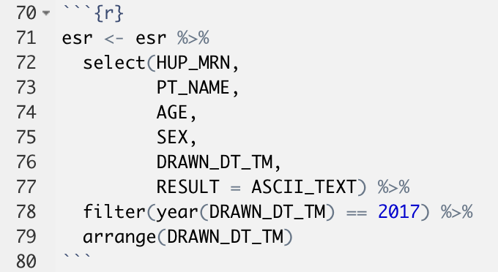
Select ASCII_TEXT but rename it to RESULT
year(x):
if x is a Date,
return the year part

Slide 16
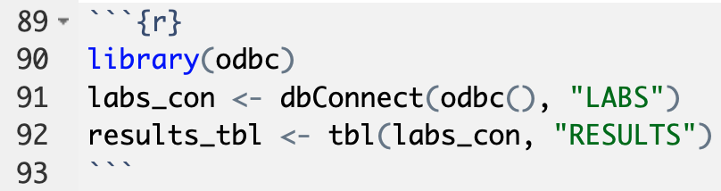
dbConnect(driver, database):
Create database connection object labs_con linking to database LABS by using the odbc() driver.
tbl(db_connection_object, db_table):
Create tbl object results_tbl linking to database table RESULTS via the connection object labs_con.

Slide 17
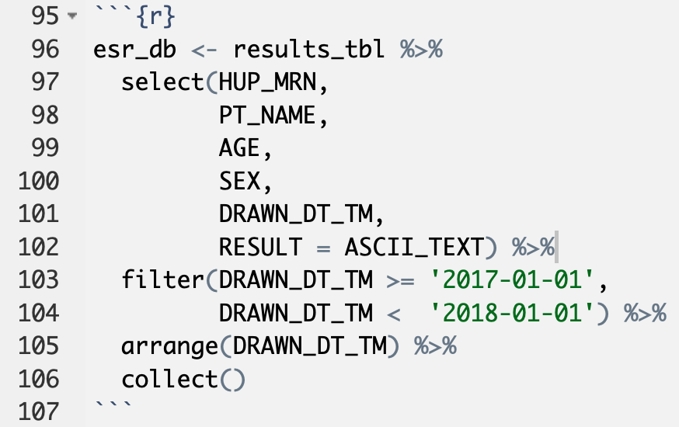
PostgreSQL doesn’t understand year()
collect():
execute full database query (without limit)
Notes:
Demo show_query(): under the hood R translates the dplyr pipeline into a SQL query

Slide 18
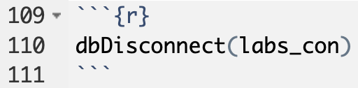

Slide 19
Background and Objectives
Data Acquisition
Data Exploration and Cleaning
Visualization and Modeling
Summary

Slide 20
“If you are comfortable with your data, it means that you haven’t looked at it.”
Al Best

Slide 21
Data Exploration and Cleaning
Convert messy data to tidy
Check for missing values
Verify (and if necessary, fix) data types
Numeric integer or numeric
Date-time: Date or POSIXct
Categorial: factor
All others: character
Visualize distributions
Numeric variables: histogram
Categorical variables: summary
Character variables: sample
Is the data as expected?
Range and shape of distribution
Number and breakdown of categories
Properties of character variables
Resolve data problems
Notes:
A good way to think about this section is that it’s where QC (Quality Control) happens.

Slide 22
How do I know the data type of each column?
chr = character
num = numeric
Factor = categorical
POSIXct = datetime
int = integer

Slide 23
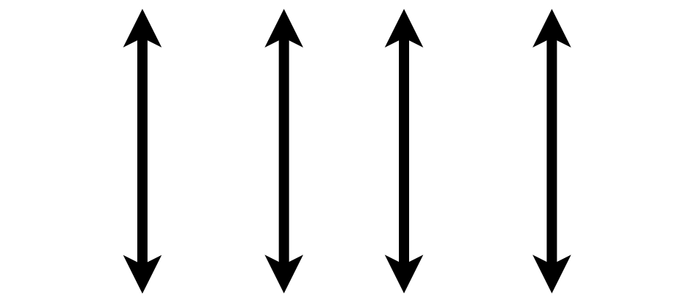

Convert Messy Data to Tidy
A data set is tidy if:
Each variable is in its own column
Each case is in its own row
Each value is in its own cell
Notes:
Review from last time: a data set is “tidy” if:
each variable is in its own column,
Each case is in its own row
Each value is in its own cell
Don’t try to analyze a data set before making it tidy first unless you know what you’re doing.
The ESR data set is tidy already. Data that come from databases often are, but not always.

Slide 24
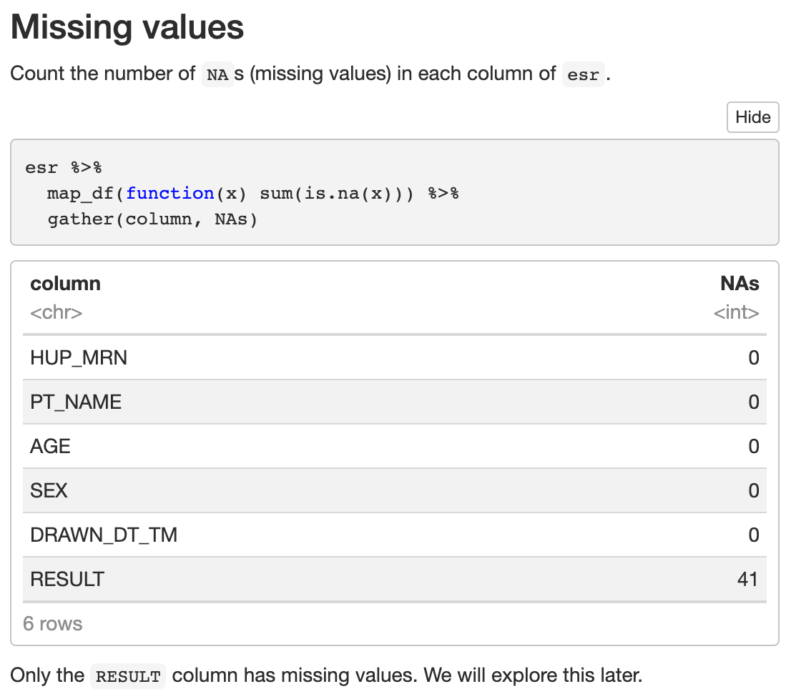
Notes:
Don’t worry about that code but be sure to include this code chunk!

Slide 25
set.seed():
set the random number generator
makes sure “random” results are reproducible
sample_n():
sample rows from a data frame
pull():
extract a single column and display it compactly
Notes:
We now go systematically column by column and do 3 things
Verify the data type (check environment tab)
Visualize the distribution (for character, can’t do more than look at a sample)
Comment on whether everything seems OK
Code bubbles: - set.seed() - sample_n() - pull()

Slide 27
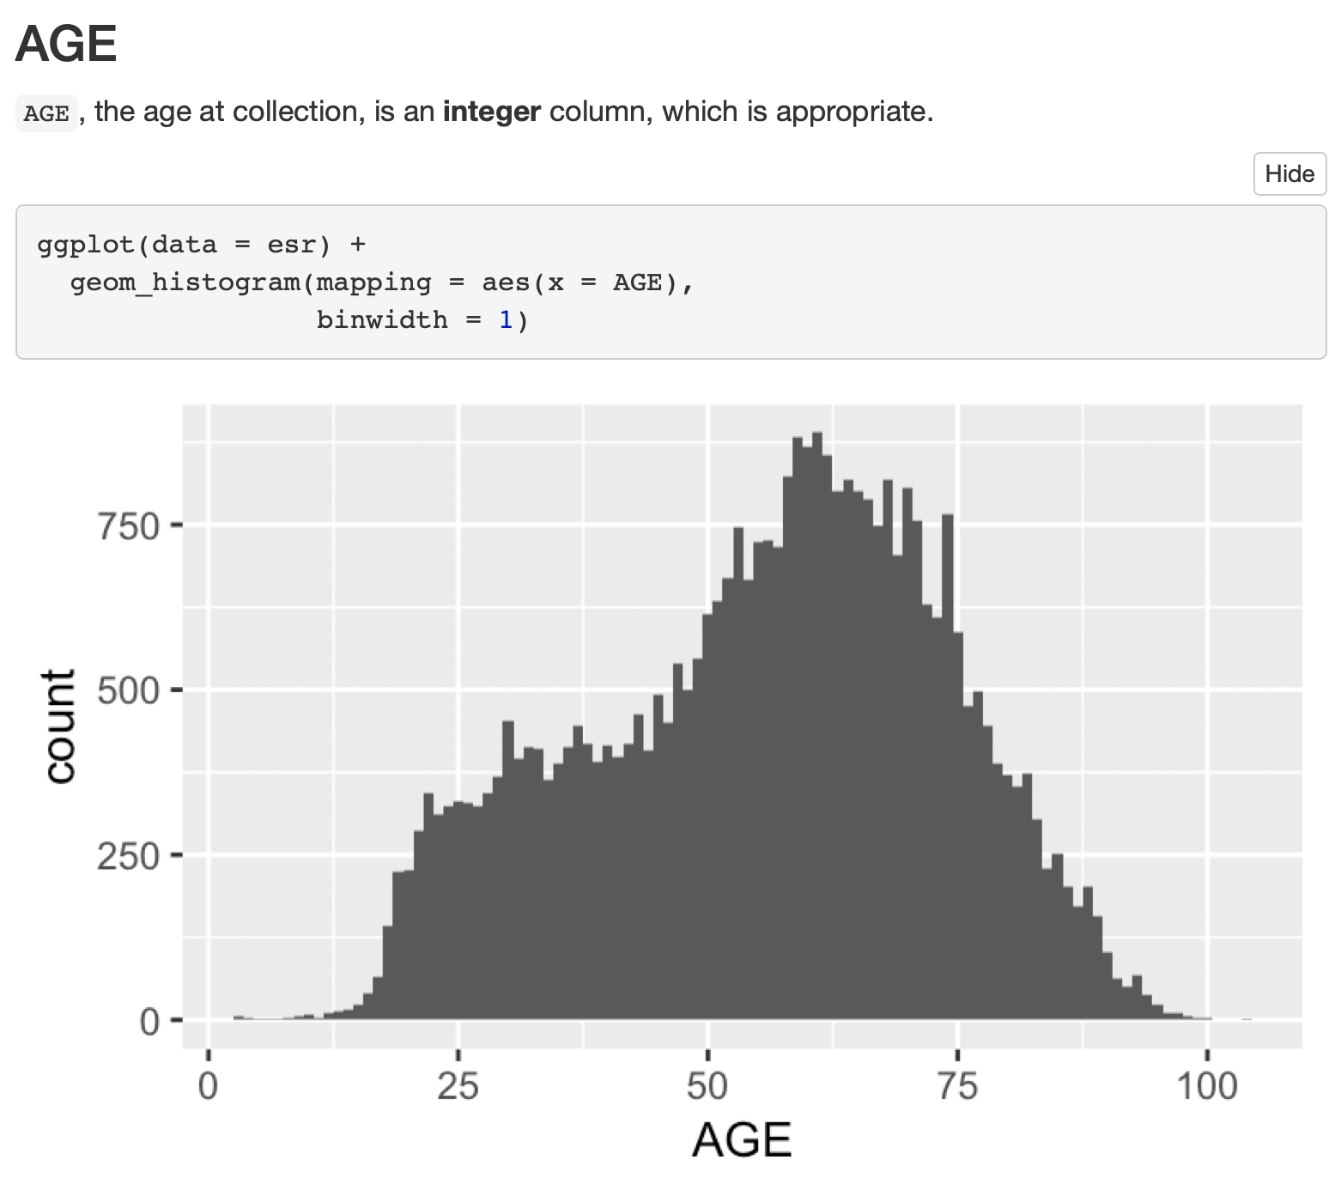
binwidth:
width of the bins of a histogram

Slide 28
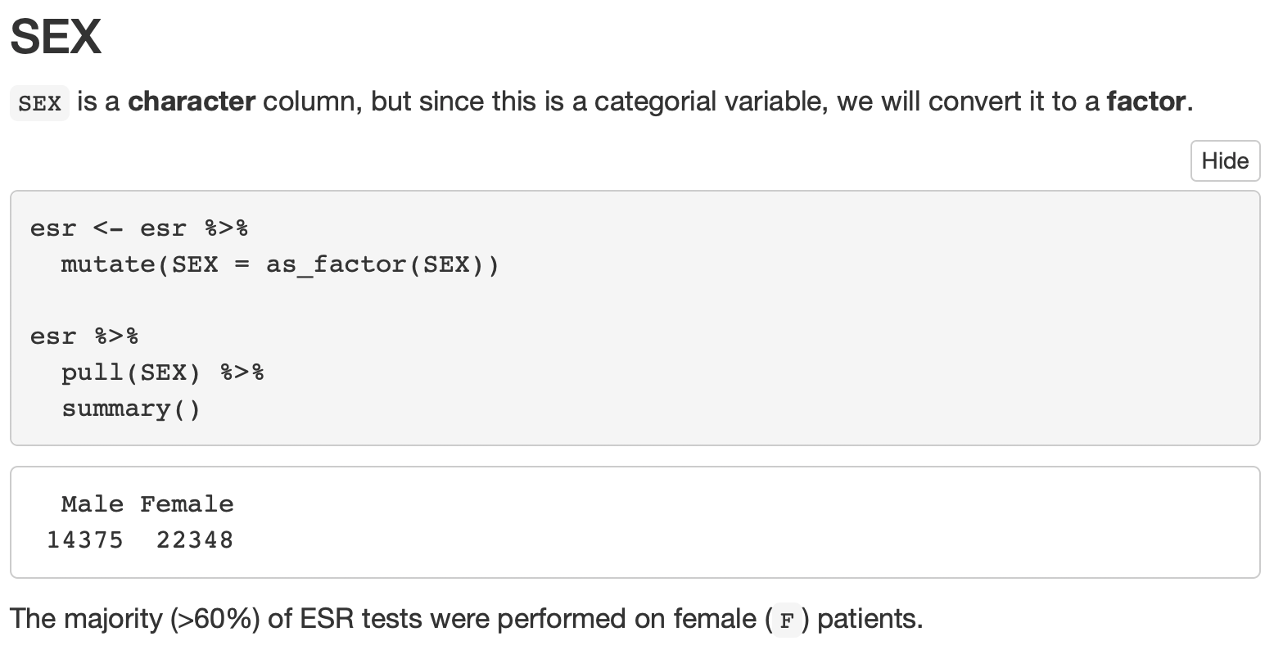
Overwrite existing SEX column
as_factor():
convert to factor
summary():
concise statistical summary

Slide 29
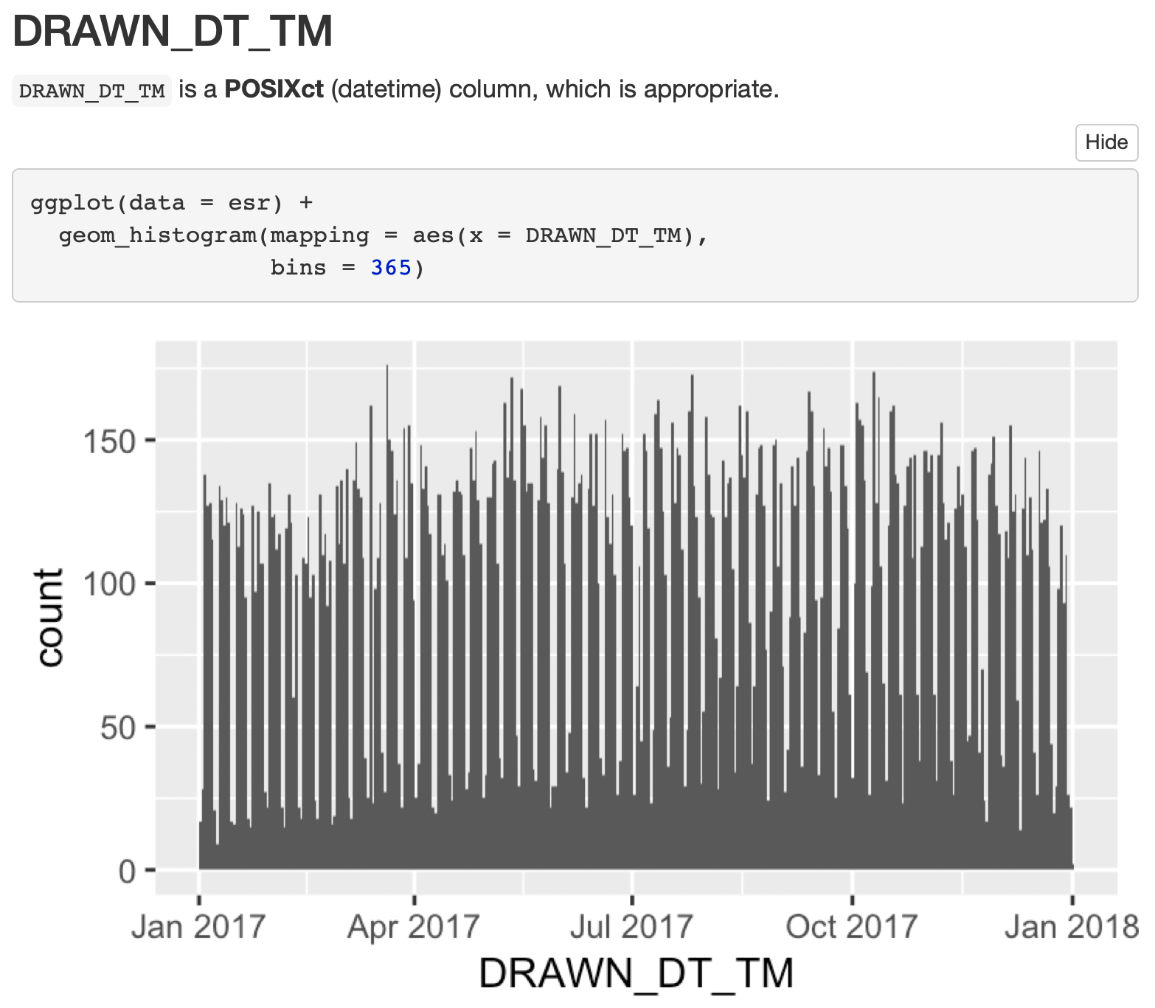
bins:
total number of bins

Slide 30
Your Turn #2
Do think that weekly ESR testing volume was constant over the course of 2017?
Can you think of a way to confirm this idea graphically?
Discuss with your group and then try to create the graph in the R Markdown document.

Slide 31
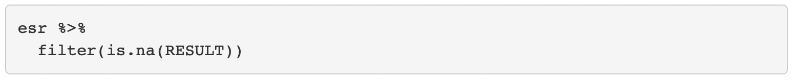
Dealing with Missing Values
Notes:
RESULTS – most problematic column.
Missing values
Character -> need to convert to numeric
<0.1% of values are missing – removing them won’t skew the distribution. Probably OK to drop them. (Probably a great idea to document that we did, and why!)

Slide 32

Conversion of Character to Numeric Types can create Missing Values!
as.integer()
"123"
"abc"
123
NA
Notes:
Character -> numeric conversion is tricky!

Slide 33
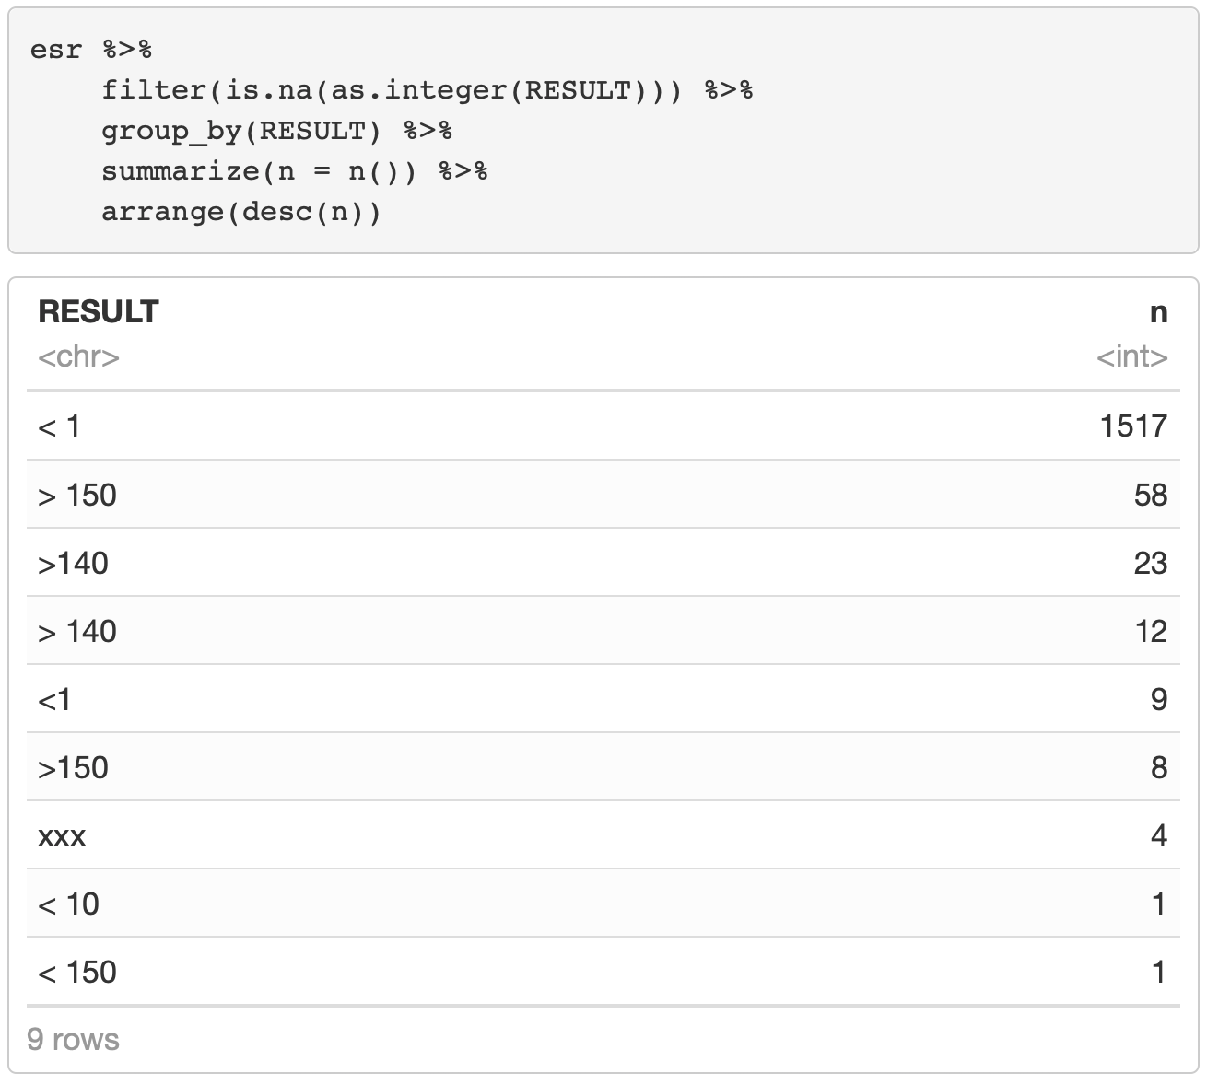
get non-numeric values of Result, in order of frequency
Notes:
- Your Turn: discuss what could account for the various non-integer RESULT values.

Slide 34
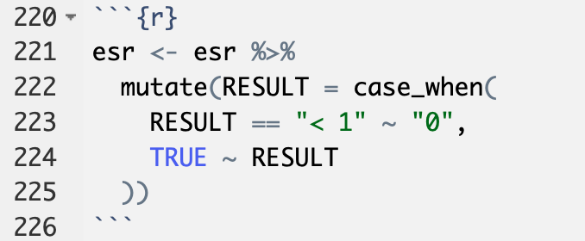
Selective Replacement
case_when(…): selectively replace values
… is a sequence of formulas of the form:
condition ~ replacement value
The final formula should always be
TRUE ~ default value
In this case:
“otherwise, keep the value of RESULT.”
Notes:
…
Now were finally ready to convert RESULT to integer, and to drop all values that this will turn into missing values.

Slide 35
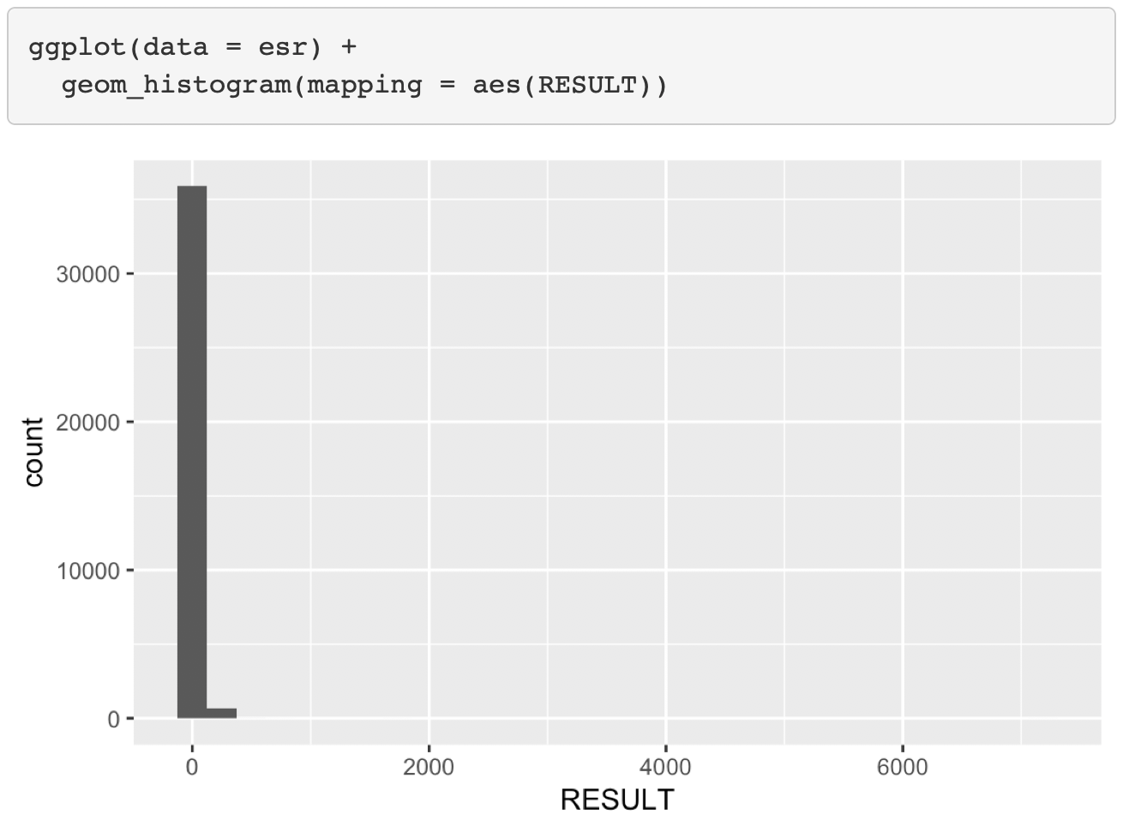
Notes:
Let’s do the histogram!
-
- What’s going on here?!

Slide 36
Notes:
Very few very high values – probably transcription errors – OK to remove.

Slide 37
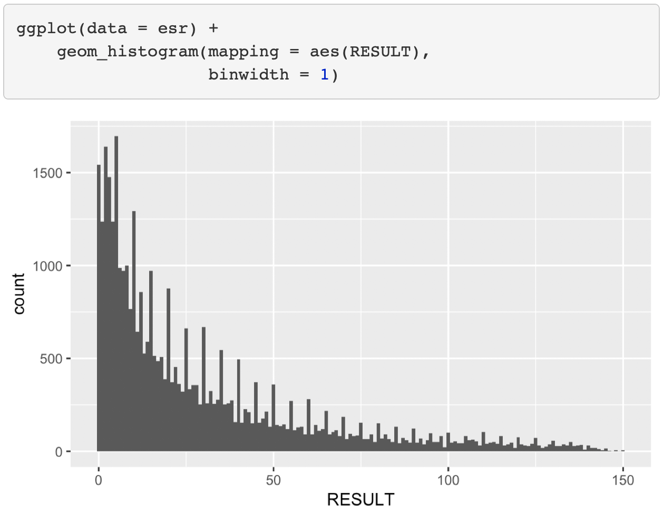

Slide 38
Your Turn #3
What do you think the regularly spaced peaks represent?
How should they be dealt with?
Discuss with your group!

Slide 39
Background and Objectives
Data Acquisition
Data Exploration and Cleaning
Visualization and Modeling
Summary

Slide 40
Visualization and Modeling
Iterative rounds of:
Pose a question or state a hypothesis.
Create a graph or statistical summary that addresses the question or tests the hypothesis.
Comment on new insights gained and new problems raised.
Notes:
Won’t actually cover code but instead, the process

Slide 41
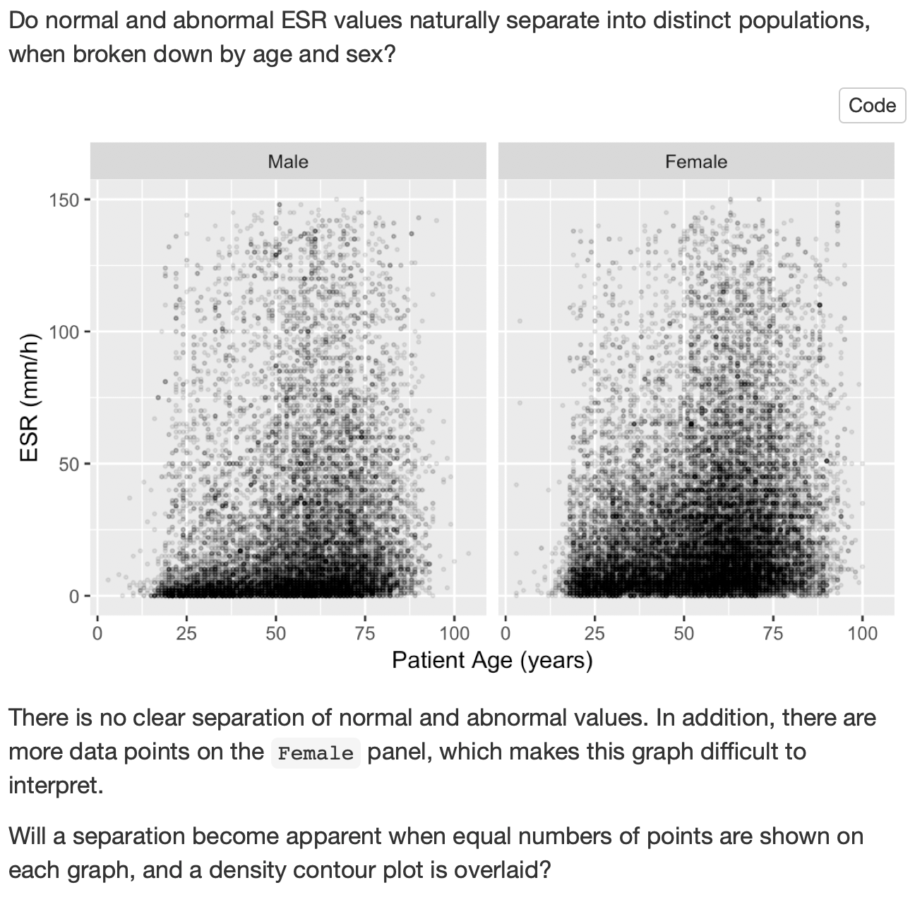
Question
Round 1
Graph
Comments

Slide 42
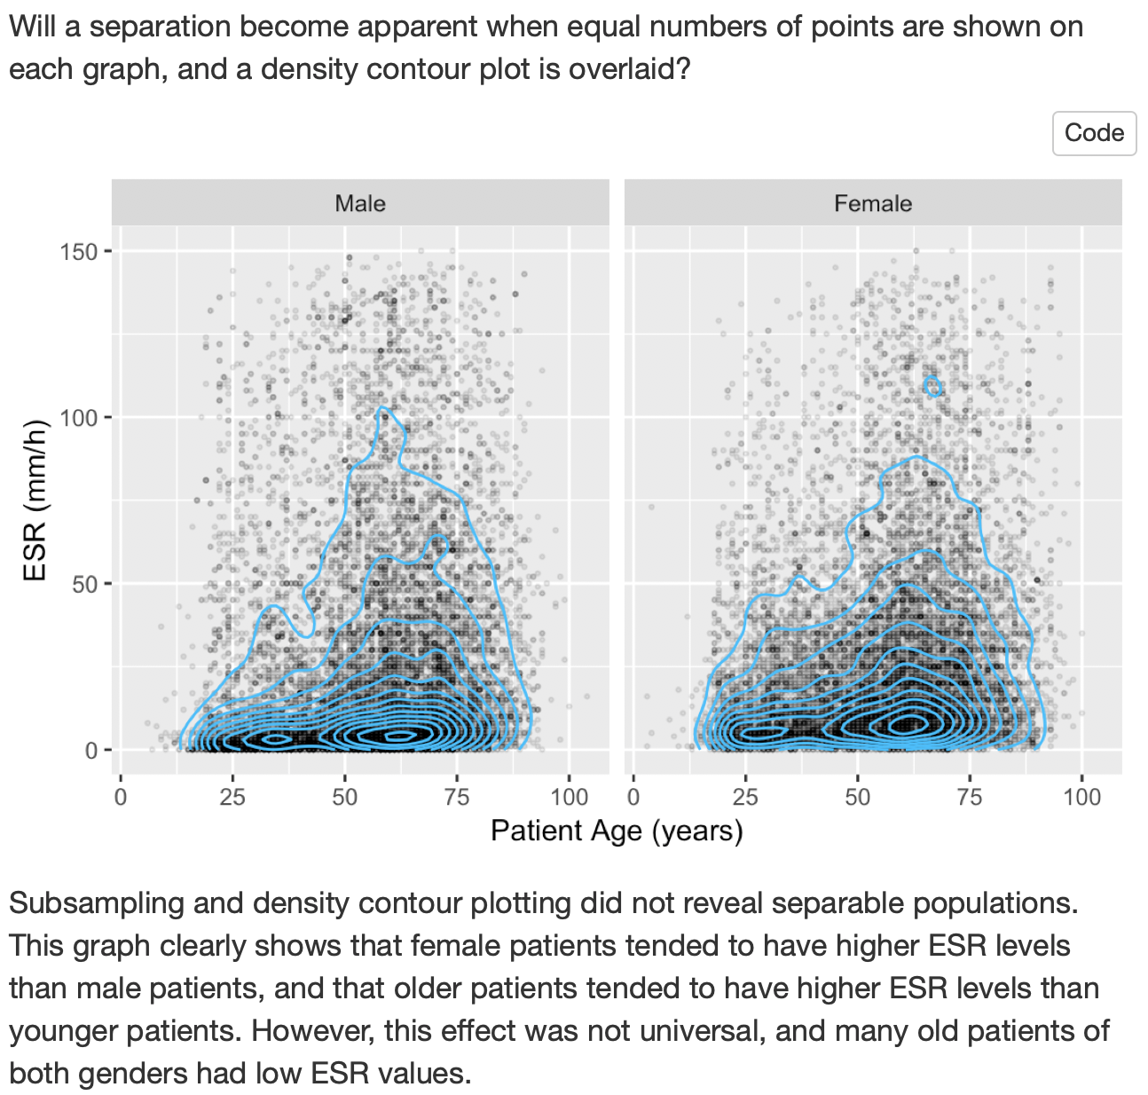
Round 2
Notes:
Subsampled 15000 points from both males and females
Overlaid density contours

Slide 43
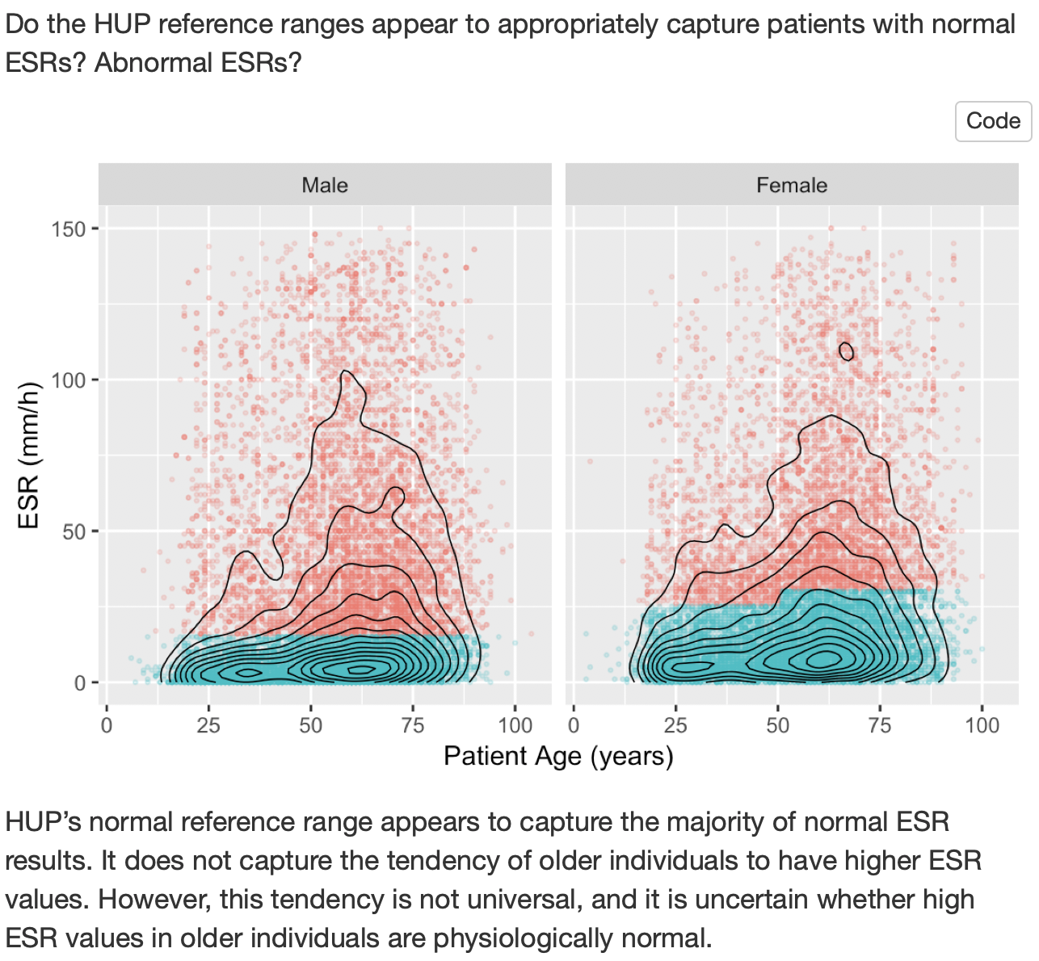
Round 3
Notes:
Subsampled 15000 points from both males and females
Overlaid density contours

Slide 45
Background and Objectives
Data Acquisition
Data Exploration and Cleaning
Visualization and Modeling
Summary
Notes:
Depends on the report and audience
Good place to recap each important result

Slide 46
Workshop Summary

Slide 47
Goals
1. Appreciate Reproducibility in Data Analysis
2. Learn a Practical Way to Analyze Clinical Data Reproducibly
Objectives
1. Define “Reproducibility” and Explain its Importance
2. Learn How to Use R/RStudio to Import Data from Files and Databases; Transform Data; and Visualize Data
3. Create a Reproducible Report Written in R Markdown
Notes:
Goals
1. Gain an appreciation for the importance of reproducibility in data analysis
2. Learn a practical approach to analyze clinical data in a reproducible fashion
Objectives
By the end of the course, you should:
1. Be able to Define “reproducibility” and explain its importance as it relates to data analysis
2. Gain confidence in your ability to use R/Rstudio to import data from files and databases; and transform and visualize data.
3. Create, with technical assistance from Dan, Amrom, and me, a reproducible report

Slide 48
Introduction
Getting Data
Exploring Data
Reproducible Reports
Reproducibility
R/RStudio
R Markdown
HIPAA and TPO exceptions
Import data from CSV, Excel, and databases
What to do when you get stuck
ggplot2 basics
Tidy data
dplyr and %>%
Best practices for exploratory data analysis
Converting data types
Dealing with missing values and data entry errors
A template for a reproducible report
Notes:
Summary of what we did in the past 6 hours together--
1st session: defined “reproducibility” and discussed why it’s is important; what’s R and what’s RStudio, and introduced R Markdown.
2nd session: reviewed HIPAA, went over how to import data into R from CSV files, Excel files; what to do when you get stuck; and we explored a clinical database with real patient data.
3rd session: barebones basics of ggplot2; tidy data, and data wrangling with dplyr
4th session: went through a reproducible data analysis that addressed a clinical question, soup to nuts, discussed its structure, and dealt with some very annoying but exceedingly common data problems including missing values, data type conversions, data entry errors and bias. I will be sending out a template reproducible report that should get you started on your course project and other projects in the future.
I hope that this has given you all a framework of mental models that will be useful for the future. And I hope that you all feel more confident now to tackle a clinical or research project with R.

Slide 49
Post-Workshop Survey

Slide 50
Notes for next time
Notes:
THIS SESSION NEEDS TO BE SCRIPTED

